Slide 1
Medical terminologies -3

Slide 2
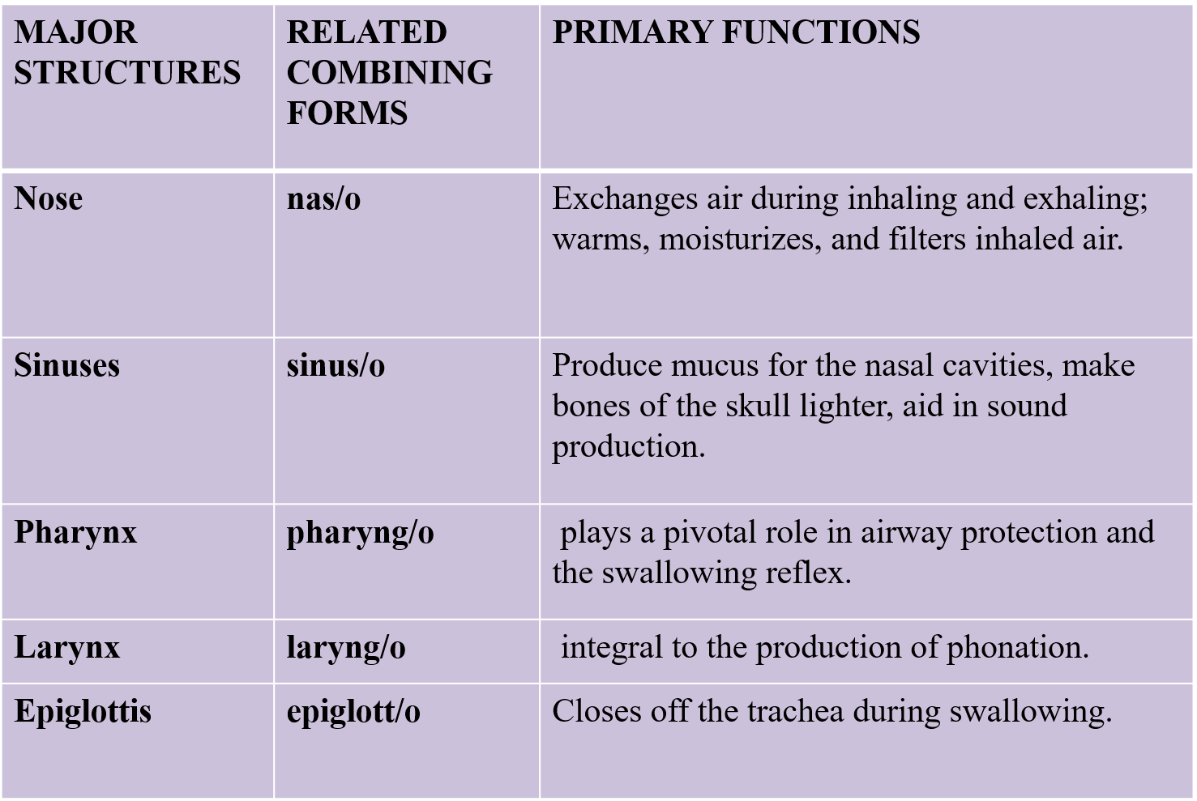

Slide 3
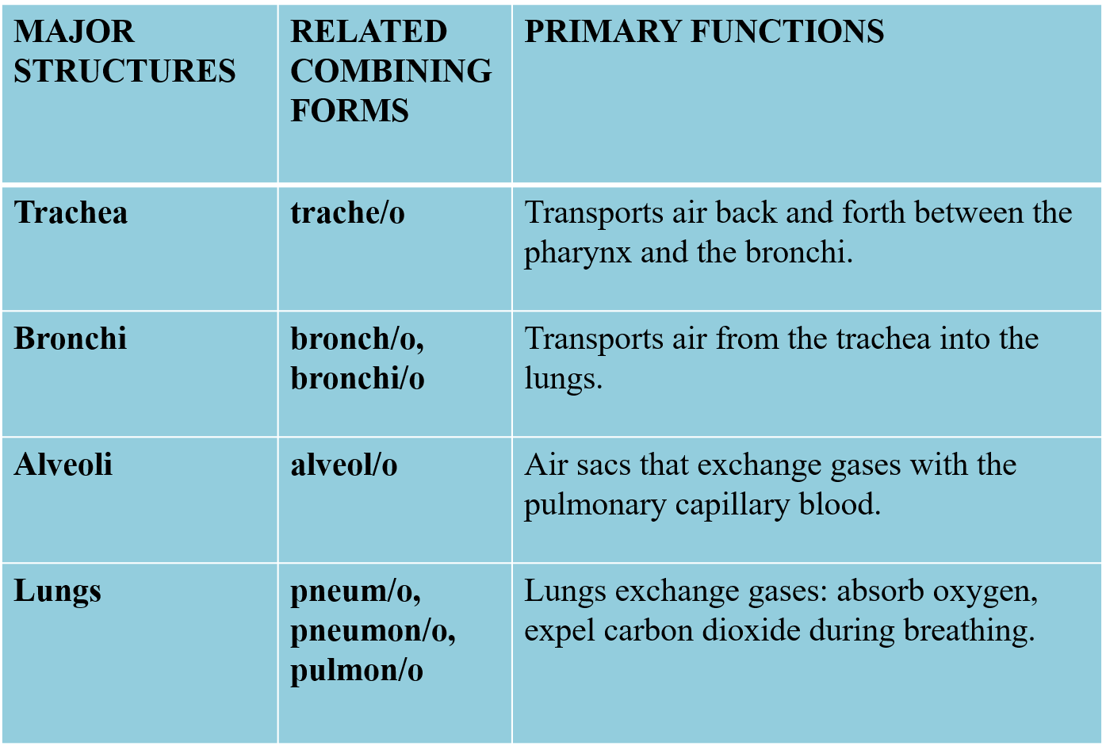

Slide 4
Func of resp. sys.
Facilitates gas exchange: supplies oxygen to blood, removes carbon dioxide.
Regulates blood pH by adjusting carbon dioxide levels.
Protects against pathogens and particulate matter through filtration and immune defense.
Produces sound and speech via the vocal cords in the larynx.
Allows for the sense of smell (olfaction) by directing air to olfactory receptors.
Moistens, warms, and filters incoming air before it reaches the lungs.

Slide 5
Str. of resp. sys.
The upper respiratory tract consists of the nose, mouth, pharynx, epiglottis, larynx
The lower respiratory tract consists of the trachea , bronchial tree and lungs. These structures are located within, and protected by, the thoracic cavity which is also known as the rib cage.

Slide 6
Nose
Air enters the body through the nose and passes through the nasal cavity, which is the interior portion of the nose.
The nasal septum (NAY-zal SEP-tum) is a wall of cartilage that divides the nose into two equal sections. A septum is a wall that separates two chambers.
Cilia (SIL-ee-ah), the thin hairs located just inside the nostrils, filter incoming air to remove debris.
Mucous membranes (MYOU-kus) are the specialized tissues that line the respiratory, digestive, reproductive, and urinary systems.

Slide 7
Nose
Mucus (MYOU-kus), which is secreted by the mucous membranes, protects and lubricates these tissues. In the nose mucus helps to moisten, warm, and filter the air as it enters. Notice the different spellings; however, they have the same pronunciation. Mucous is the name of the tissue; mucus is the secretion that flows from the tissue.
The olfactory receptors (ol-FACK-toh-ree) are nerve endings that act as the receptors for the sense of smell. They are also important to the sense of taste. These receptors are located in the mucous membrane in the upper part of the nasal cavity.

Slide 8
Tonsils
The tonsils form a protective circle of lymphatic tissue around the entrance to the respiratory system.
The paranasal sinuses, which are air-filled cavities lined with mucous membrane, are located in the bones of the skull.
These sinuses are connected to the nasal cavity via short ducts (para- means near, nas means nose, and -al means pertaining to).
The functions of these sinuses are
to make the bones of the skull lighter,
to help produce sound by giving resonance to the voice, and
to produce mucus to provide lubrication for the tissues of the nasal cavity.
The four paired sinuses are located on either side of the nose and are named for the bones in which they are located

Slide 9
Paranasal sinuses
The frontal sinuses are located in the frontal bone just above the eyebrows. An infection here can cause severe pain in this area.
The sphenoid sinuses, which are located in the sphenoid bone, are close to the optic nerves and an infection here can damage vision.
The maxillary sinuses, which are the largest of the paranasal sinuses, are located in the maxillary bones. An infection in these sinuses can cause pain in the posterior maxillary teeth.
The ethmoid sinuses, which are located in the ethmoid bones, are irregularly shaped air cells that are separated from the orbital (eye) cavity by only a thin layer of bone.

Slide 10
Pharynx
The pharynx is a muscular, funnel-shaped tube approximately 12–14 cm long, located in the midline of the neck.
The posterior portion of the nasal and oral cavities open into a region called the pharynx.
NASOPHARYNX – situated behind the nasal cavity and above the soft palate.
OROPHARYNX –posterior region of the oral cavity that spans the space between uvula and upper rim of epiglottis.
HYPOPHARYNX –extends from the upper rim of epiglottis to the opening between the vocal cords.

Slide 11
Pharynx
The pharynx is a muscular, funnel-shaped tube approximately 12–14 cm long, located in the midline of the neck.
The posterior portion of the nasal and oral cavities open into a region called the pharynx.
NASOPHARYNX – situated behind the nasal cavity and above the soft palate.
OROPHARYNX –posterior region of the oral cavity that spans the space between uvula and upper rim of epiglottis.
HYPOPHARYNX –extends from the upper rim of epiglottis to the opening between the vocal cord
The laryngopharynx is lined with non ciliated stratified squamous epithelium.
The laryngopharynx plays a crucial role in preventing aspiration; that is, stopping food and liquid particles from entering the airway

Slide 12
Larynx
The larynx (LAR-inks), also known as the voice box, is a triangular chamber located between the pharynx and the trachea.
The larynx is protected and supported by a series of nine separate cartilages. The thyroid cartilage is the largest, and when enlarged, it is commonly known as the Adam’s apple.
The larynx contains the vocal cords (glottis). During breathing, the cords are separated to let air pass. During speech, they close together, and sound is produced as air is expelled from the lungs, causing the cords to vibrate against each other.
The base of the tongue is attached to the epiglottis, these folds form a space between the tongue and epiglottis called VALLECULLA, key for oral intubation
The inside cavity of the larynx can be divided into 3 sections- The supraglottis (the area above the vocal cords) The glottis (the area that includes the vocal cords) The subglottis (the area below the vocal cords)

Slide 13
trachea
The trachea (TRAY-kee-ah), commonly known as the windpipe, is the tube located directly in front of the esophagus that extends from the neck to the chest. Its role is to transport air to, and from, the lungs.
The trachea is held open by a series of C-shaped cartilage rings. The wall between these rings is flexible, and this feature makes it possible for the trachea to adjust to different body positions.

Slide 14
Bronchi
The bronchi (BRONG-kye) are formed where the trachea divides into two branches known as the primary bronchi (singular, bronchus). Because of the similarity of these branching structures to an inverted tree, this is referred to as the bronchial tree with one branch going into each lung.
Within the lung, each primary bronchus divides and subdivides into increasingly smaller bronchioles (BRONG-kee-ohlz), which are the smallest branches of the bronchi.

Slide 15
Alveoli
Alveoli (al-VEE-oh-lye), also known as air sacs, are the very small grape-like clusters found at the end of each bronchiole (singular, alveolus). Each lung contains millions of alveoli that are filled with air from the bronchioles.
A network of microscopic pulmonary capillaries surrounds the thin, elastic walls of the alveoli.
During respiration, the exchange of oxygen and carbon dioxide between the alveolar air and the pulmonary capillary blood occurs through the walls of the alveoli

Slide 16
Lungs
The lungs, which are the organs of respiration, are divided into lobes. A lobe is a subdivision or part of an organ.
The right lung has three lobes: the superior, middle, and inferior.
The left lung has only two lobes: the superior and inferior. It is slightly smaller than the right lung because of the space taken up by the heart.
The lungs produce a detergent-like substance, known as a surfactant, which reduces the surface tension of the lungs. This allows air to flow over the lungs and be absorbed more easily.

Slide 17
Mediastinum
The Mediastinum (mee-dee-as-TYE-num) is the cavity located between the lungs. This cavity contains connective tissue and organs, including the heart and its veins and arteries, the esophagus, trachea, bronchi, the thymus gland, and lymph nodes.

Slide 18
Pleura
The pleura (PLOOR-ah) is a thin, moist, and slippery membrane that covers the outer surface of the lungs and lines the inner surface of the rib cage.
The Parietal pleura (pah-RYE-eh-tal) is the outer layer of the pleura that lines the walls of the thoracic cavity, covers the diaphragm, and forms the sac containing each lung. Parietal means relating to the walls of a cavity.
The Visceral pleura (VIS-er-al) is the inner layer of pleura that surrounds each lung. Visceral means relating to the internal organs.
The pleural cavity, also known as the pleural space, is the airtight area between the layers of the pleural membranes. This space contains a thin layer of fluid that allows the membranes to slide easily during breathing.

Slide 19
Diaphragm
The diaphragm (DYE-ah-fram) is the muscle that separates the thoracic cavity from the abdomen. It is the contraction and relaxation of this muscle that makes breathing possible. The phrenic nerves (FREN-ick) stimulate the diaphragm and cause it to contract.

Slide 20
Respiration
Respiration is the exchange of oxygen and carbon dioxide that is essential to life. A single respiration consists of one inhalation and one exhalation.
Inhalation (in-hah-LAY-shun) is the act of taking in air as the diaphragm contracts and pulls downward. This action causes the thoracic cavity to expand. This produces a vacuum within the thoracic cavity that draws air into the lungs.
Exhalation (ecks-hah-LAY-shun) is the act of breathing out. As the diaphragm relaxes, it moves upward, causing the thoracic cavity to become narrower. This action forces air out of the lungs.

